Slide 1
Subject Name :Database Management System Presentation Title: Database Admin
JEPPIAAR INSTITUTE OF TECHNOLOGY
“Self-Belief | Self Discipline | Self Respect”
Department of Computer Science and Engineering
Team Members:
Students Name Reg.No:
1. LIROSHIN L 210618104028
2. MUTHUKRISHNAN P R 210618104031
3. RAGUL.R 210618104037
4. RUBAN MELO X 210618104040
5. SANGAM MALLA B 210618104041
6. SURIYA K 210618104051

Slide 2
Objective
To Design/ Analyze/ Evaluate
A database administrator (DBA) is a specialized
computer systems administrator who a successful
database environment by directing or performing all
related activities to keep the data secure.

Slide 3
Technical Details

Slide 4
Block Diagram/ Work Flow/ Flow Chart

Slide 5
Technical Details

Slide 6
Technical Details

Slide 7
Threats to Data Security
Accidental losses attributable to:
Human error
Software failure
Hardware failure
Theft and fraud
Improper data access:
Loss of privacy (personal data)
Loss of confidentiality (corporate data)
Loss of data integrity
Loss of availability

Slide 8
Database Recovery
Mechanism for restoring a database quickly and accurately after loss or damage
Recovery facilities:
Backup Facilities
Journalizing Facilities
Checkpoint Facility
Recovery Manager

Slide 9
Responsibilities of DBA
• Ensuring that the database is up and running all the time.
• Pre-implementation tasks such as feasibility study, capacity planning, installation and implementation activities.
.
• Migrating existing data from legacy platforms such as text files and spreadsheets.
• Designing and implementing backup and restore startegies

Slide 10
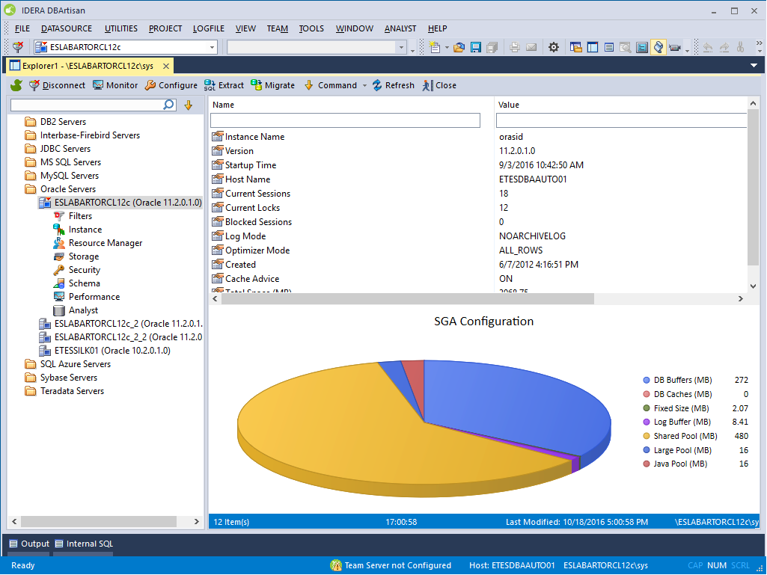
Result & Discussion

Slide 11
Future Scope

Slide 12
Reference

